Slide 1
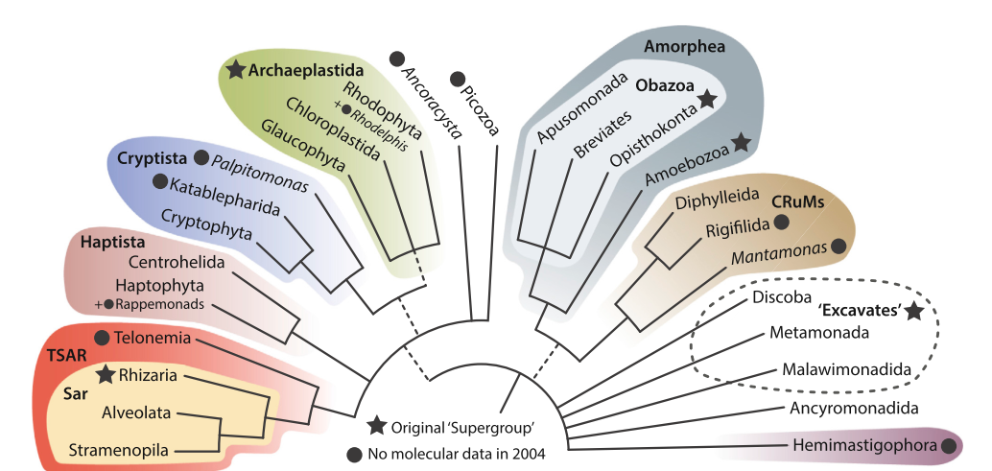
Eukaryote diversity
Sex „well evidenced“
Sex „well evidenced“

Slide 2
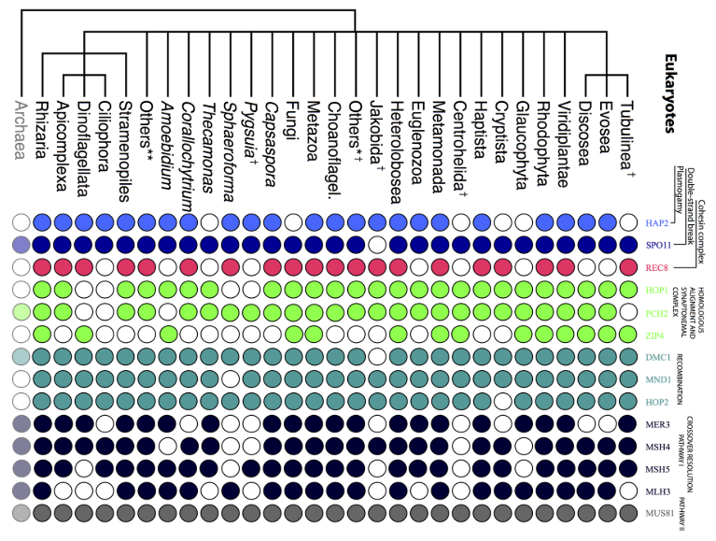
People argue since so called „meiosis genes“ are
present in most eukaryotes all protists must be sexual

Slide 3
Eukaryote diversity
Most „meiosis genes“ present

Slide 4
Main question: Which genes are upregulated during observable sex in protists?

Slide 5
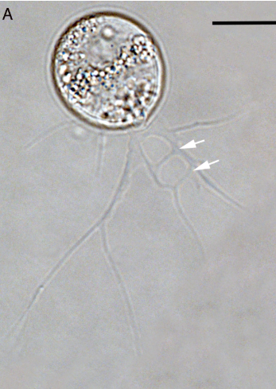
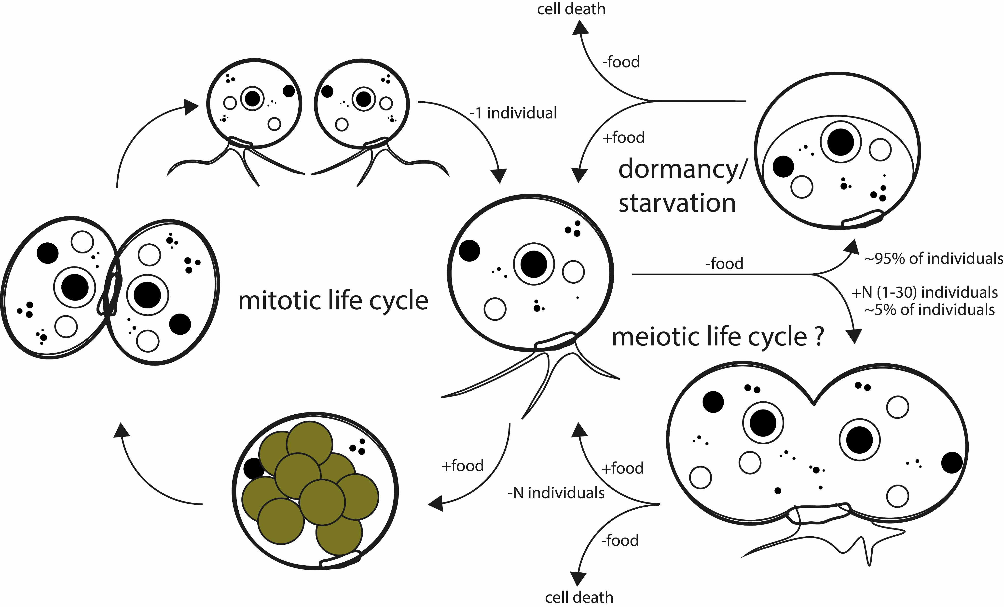
Life cycle of Fisculla terrestris

Slide 6
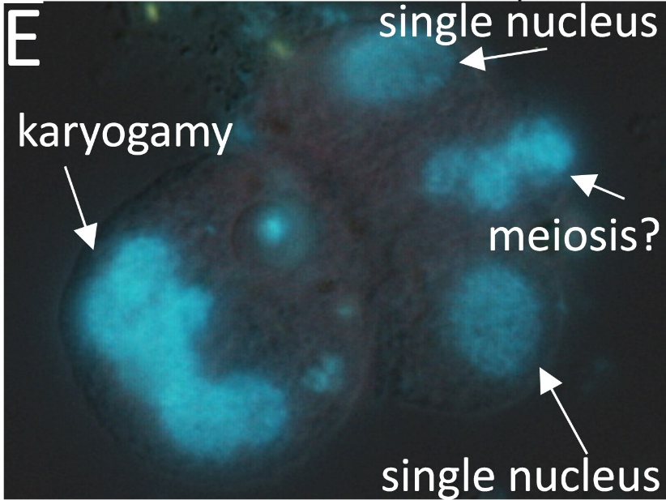
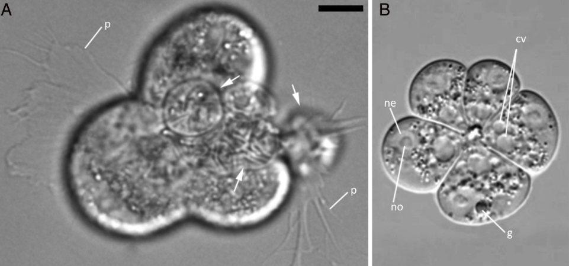
Nuclei fuse during cell aggregation

Slide 7
Differential expression experiment
Treatment 1:
high mitotic growth
low putative meiosis
food present (S. cerevisiae)
five replicates – RNA extracted
Treatment 2:
Low mitotic growth
high putative meiosis
food absent/lowly abundant
five replicates – RNA extracted

Slide 8
Intended workflow
RNA assembly
contamination removal (in particular S. cerevisiae)
create reference transcriptome
map mRNA reads against reference
functional assignment of putative meiosis genes
stastical comparison of expression

Slide 9
Structure of the paper
1.RNA-seq assembly
2. DEGs detect
3.Enriched pathway and a example, like meiosis, DNA repair, Biosynthesis of antibiotics
4.pcr validatiion

Slide 10
1.RNA-seq assembly
Raw data
Clean data
Trinity assembly
Get longest transcription
Results | Trinity assembly | Unigenes | Cd-hit transcriptions | Transdecoder to Protein | Protein cd-hit
Num | 43531 | 40050 | 36525 | 26868 | 26580
Cd-hit cluster
Rsem quantify
DEGs
Protein seq
Enrichment

Slide 11
2. DEGs detect
Results | Trinity assembly | Unigenes | Cd-hit transcriptions | Transdecoder to Protein | Protein cd-hit
Num | 43531 | 40050 | 36525 | 26868 | 26580
Adjust-P value
DEGs | Protein
16474 | 15327

Slide 12
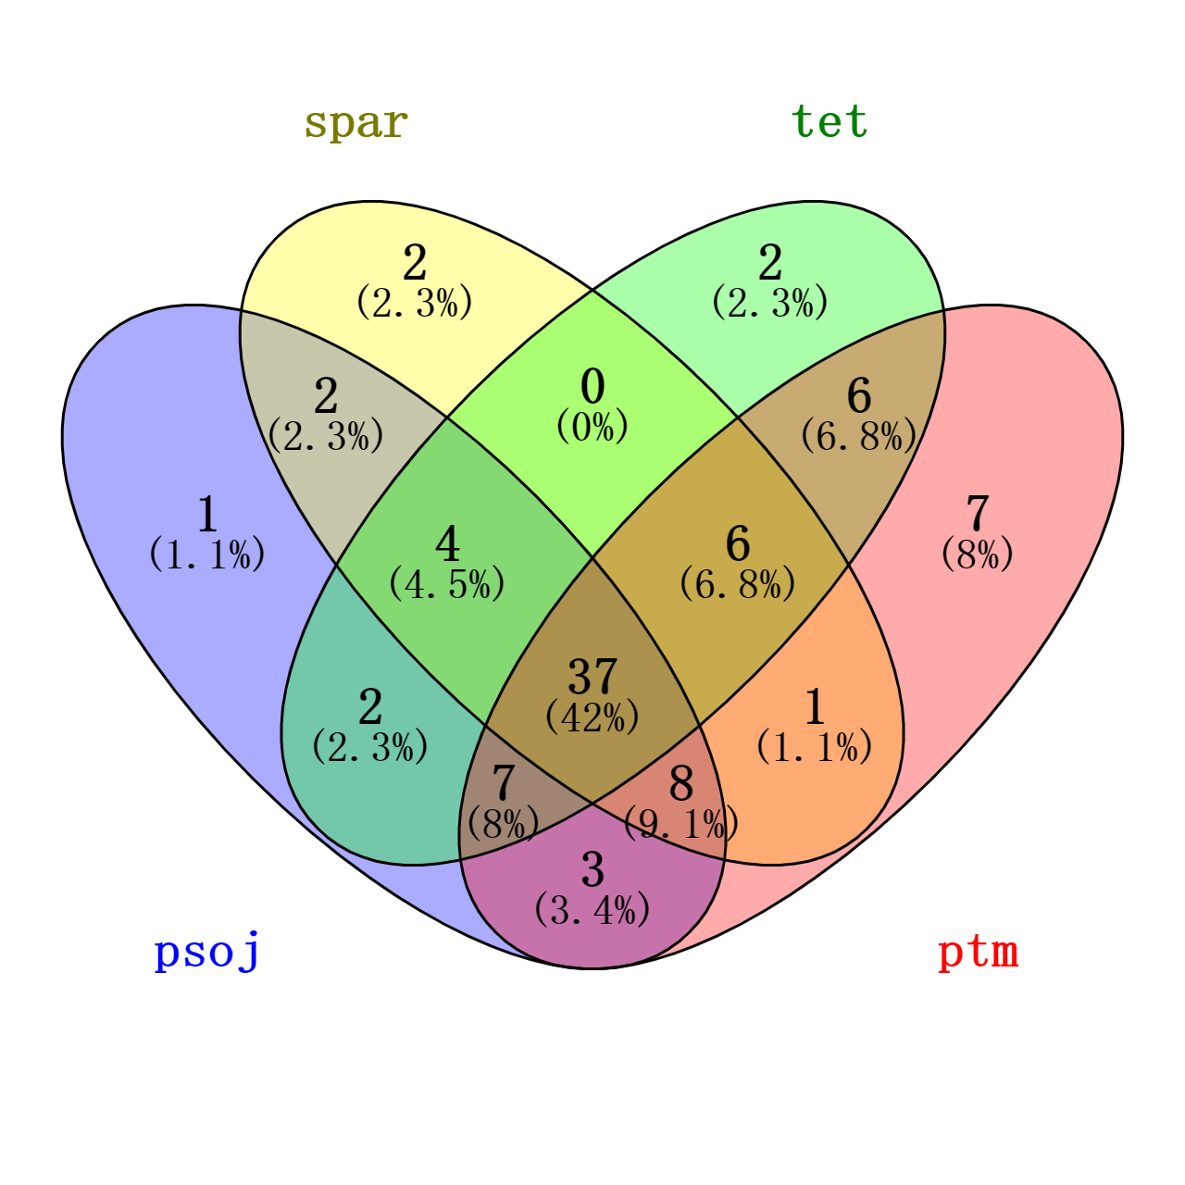
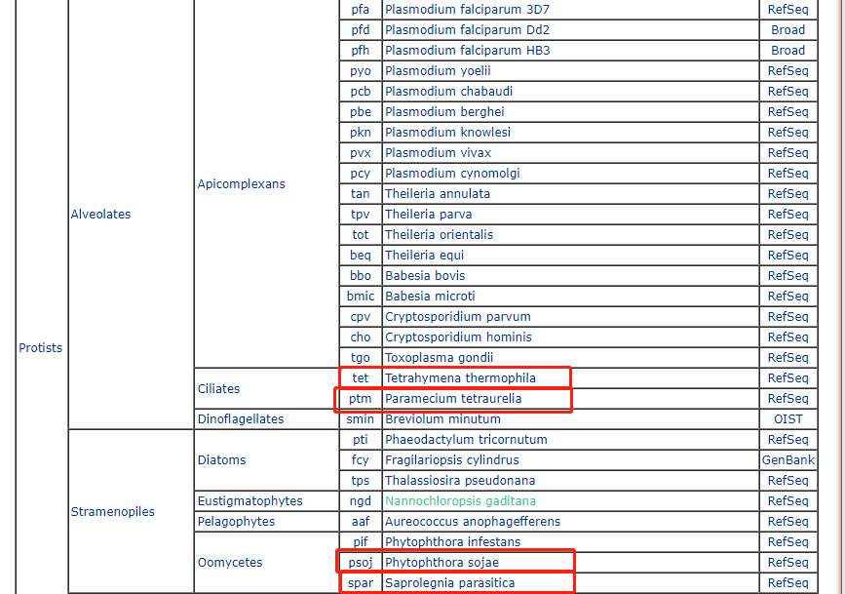
3.Enriched pathway and a example
Using 4 close species for annotation and enrichment and 37 shared

Slide 13
Metabolic pathways
Biosynthesis of antibiotics
Biosynthesis of secondary metabolites
Carbon metabolism
RNA transport
Ubiquitin mediated proteolysis
Peroxisome
Purine metabolism
Biosynthesis of amino acids
Ribosome biogenesis in eukaryotes
Oxidative phosphorylation
Nucleotide excision repair
DNA replication
Glycerophospholipid metabolism
Fatty acid degradation
Cysteine and methionine metabolism
Glutathione metabolism
Arginine and proline metabolism
Propanoate metabolism
beta-Alanine metabolism
Fatty acid metabolism
N-Glycan biosynthesis
Mismatch repair
Homologous recombination
Alanine, aspartate and glutamate metabolism
Base excision repair
Lysine degradation
Pentose phosphate pathway
Pyruvate metabolism
Ether lipid metabolism
Glyoxylate and dicarboxylate metabolism
Aminoacyl-tRNA biosynthesis
Glycolysis / Gluconeogenesis
Biosynthesis of unsaturated fatty acids
Glycerolipid metabolism
Fatty acid biosynthesis
Terpenoid backbone biosynthesis

Slide 14

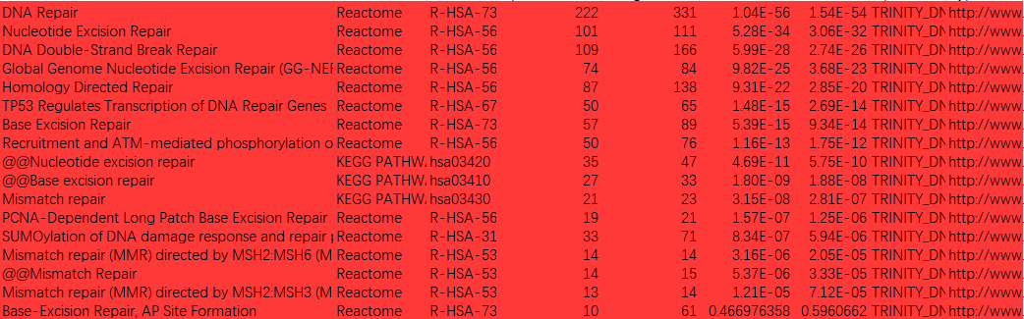



Pathway found in human database

Slide 15
4.pcr validatiion
Pick some genes of the pathway we interested

Slide 16
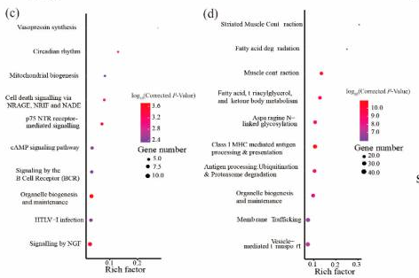
Top 10-20 pathways blobplot
One pathways with the DEGs
DEG compare in the two groups

